Slide 1
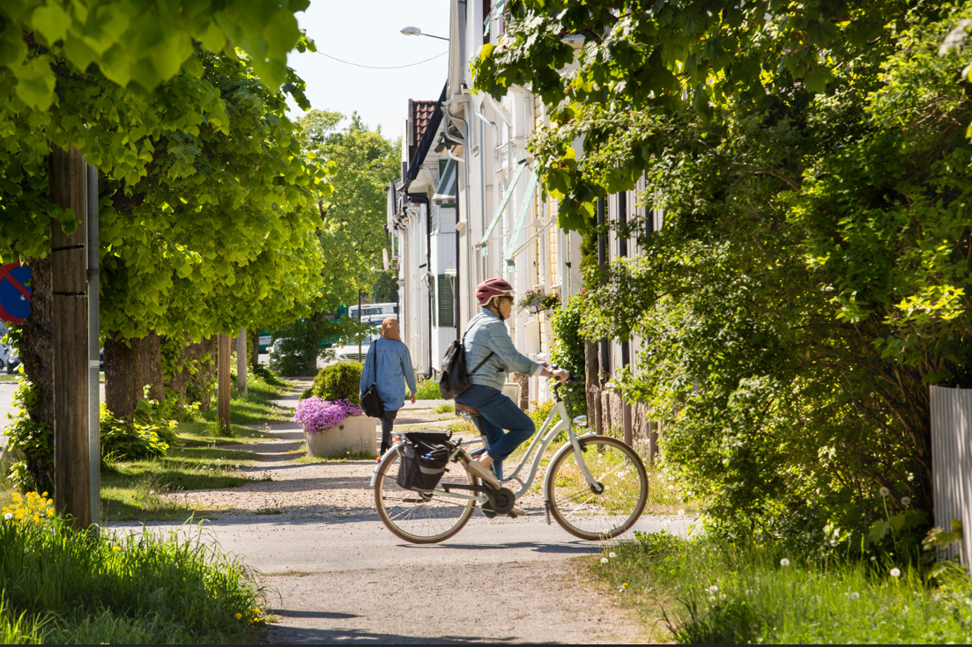
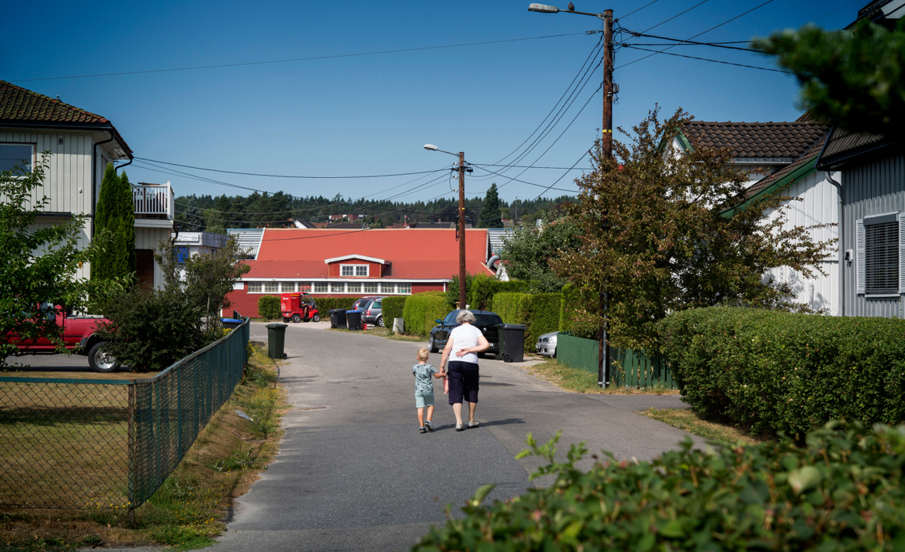
Place based approach to social sustainability by Edel Pavlic
17.March 2021
Notes:
I’m here to tell you about Fredrikstad kommunes place based approach in our work for social sustainability.
Fredrikstad has some experience with place based approaches. Recently the intersectoral overall strategy for health promotion in socially deprived neighbourhoods is after many years of writing and promoting- finally politically endorsed - so we have reached an important milestone in our work.
I will for the next half hour tell you in a none chronological order
what we mean by a place based approach,
why we are working in this way,
and what we expect to achieve.
I will end by sharing an example of a project in a deprived neighbourhood where we have been testing out asset based community development.

Slide 2
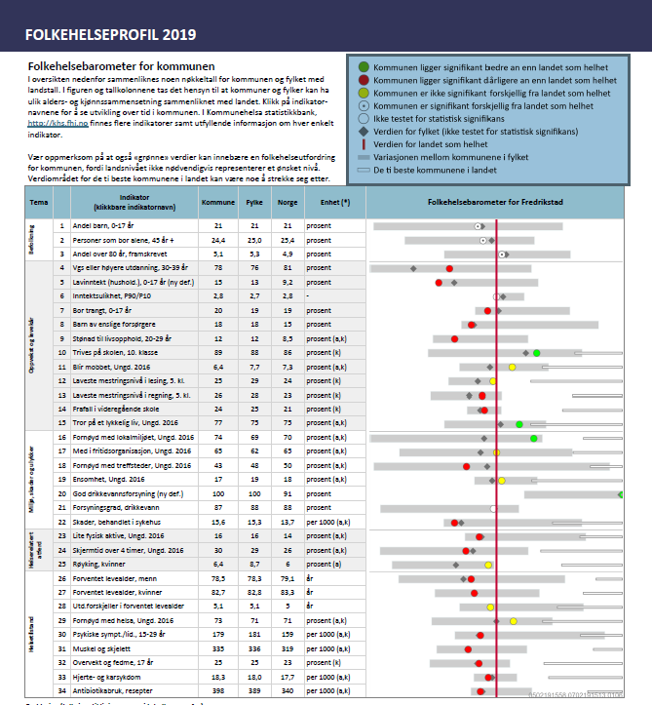
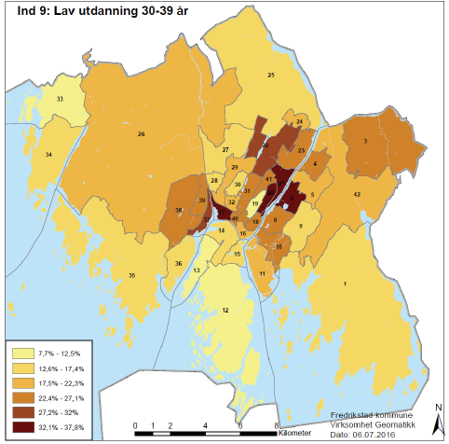
Public health challenges in Fredrikstad
Notes:
First a little background information in understanding the city of Fredrikstad:
This is a city with a lot of resources. We’re proud of your beautiful nature, our long historical roots, and a thriving and diverse cultural scene.
People report they like the life here and feel a high degree of well-being and safety.
Althoug this is true, we have, compared to the rest of our country of Norway, under average scores on serveral health indicators:
People here report more mental health issues
There are more children living in households with financial challenges - struggels of poverty
We have a high procentage of school drop outs – from 16 and onwards
Youths are less happy with the amount and the standard of social meeting places,
The kids here also spend more time online on screen, and are less physical active
These challenges are also distributed uneqally throughout the municipality. As an example, in one area there are 3,8 % of the children living in a household with low economy, versus 45,6 % in an other area.
The city is becoming more and more segregated and the differences between the poor and rich is increasing.
We acknowledge that this is just one part of the picture, and that all neighbourhoods have qualities and resources.
Still, growing up and living in neighbourhoods with social and economic challenges, is connected to many negative health outcomes.
The municipality has a responsability to create equal

Slide 3
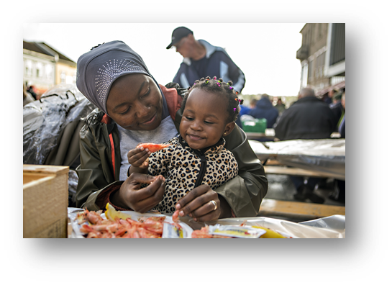
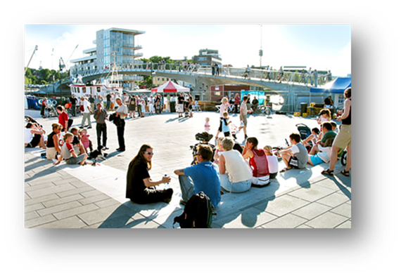
In line with the social element of the municipal «masterplan»
Fredrikstad is a good place to live, where all people can make healthy choises and experience mastery.
Notes:
The place based approach is one of many strategies our administration have produced and is in line with the municipality’s masterplan.
One specific goal is that people in Fredrikstad should felle it is a good place to live, where everybody can make healthy choices and have an impact on their way of living.
Other strategies to achieve these goals we also work with is
- Prevention – give all citizens a good start in life focus on children all ages
Provide high quality services for all citizens
Create a well balanced housing- and area policy
Implement local democracy Through «lokalsamfunnsmodellen» which Vegard talked about
Working with and for deprived neighbourhoods

Slide 4
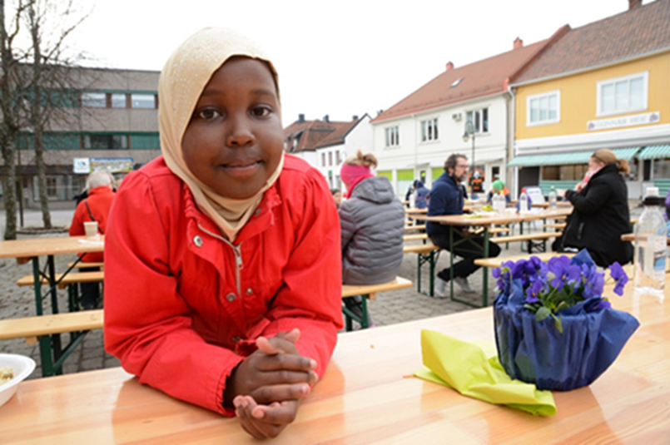
What do we mean by a place based approach?
Multilevel interventions in a social deprived area
The physical envirmonment
The social environment
Services
Supplement to the general public health effort
Notes:
Hopefully so far I have managed to put my line of work in a context and I will noe be more specific.
A place-based approach targets an entire local community and aims to address issues that exist at the neighbourhood level.
This can be things such as poor condition in housing, social isolation, poor or fragmented service provision that leads to gaps or duplication of effort, and limited economic opportunities.
The approach seek to improve the social, cultural, economic and physical environment, as well as the public services that are provided.
In a place based approach, community and stakeholder agencies collaborate to address health and contextual factors influencing social well-being for the population within a defined geographic location.
The approach employs multilevel intervention strategies to address issues that impact peoples health.

Slide 5
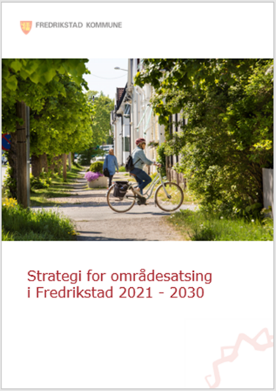
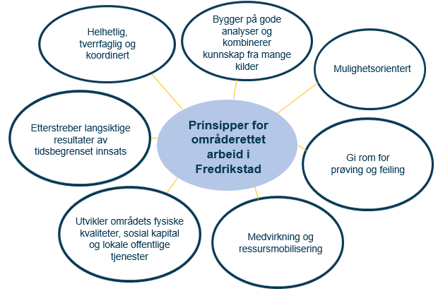
Fredrikstads strategy for place based approaches
Notes:
To sucseed with a place based approach, these 7 factors needs to be the baseline of every project
It has to be a cross-sectoral collaboration
Use a broad spectre of place and citizen analysis combined with local knowledge and experiences with public services
Seek opportunities and think outside the box
Give room for testing and failure
Citizen participation and strength-based approach in mobilising resources inside communities
Develop and enhance public spaces and public services
Prioritize sustainable solutions within a timelimites framework
The strategy desribes how to address complex community challenges by aligning public and private partnerships while fully engaging citizens in developing their communuties.

Slide 6
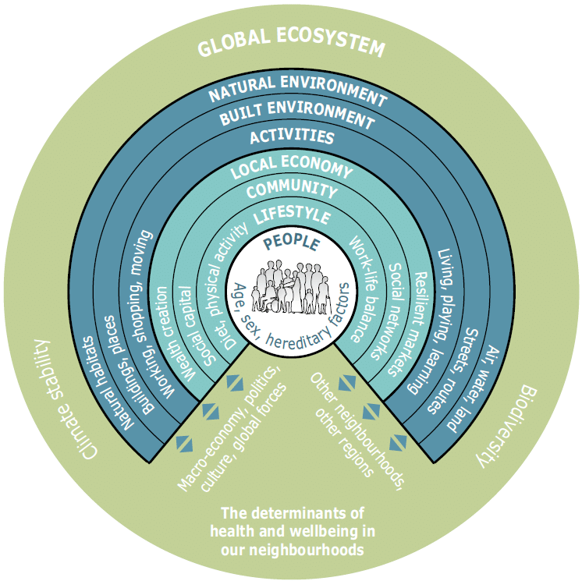
Determinants for health and wellbeing in neighbourhoods
Notes:
The approach is based on the belief that people’s health and wellbeing is a product of serveral determinants on different levels, and the neighbourhood being an important one.

Slide 7
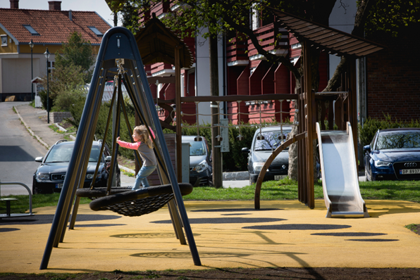
Expected results
Increased collective assets
Social meeting places
Social capital
Access to good services
The possibility to influence and participate
Feeling of safety and trust
Nature, fresh air and recreation
Contribute to sustaining a social mix
Influence identity
Notes:
Through the place based approach we aim to increase the collective assets of an area, such as social meeting places, social capital, access to good meeting places, the development of social capital, access to good services, the possibility to influence and participate in the community, the feeling of safety and trust, nature fresh air and recreation.
We also aim to contribute to a social mix in the area, meaning people with differenet income and educationL level living side-by-side.
This increases social mobility and the next slide is how we think we can create good neighbourhoods for the citizens in Fredrikstad.

Slide 8
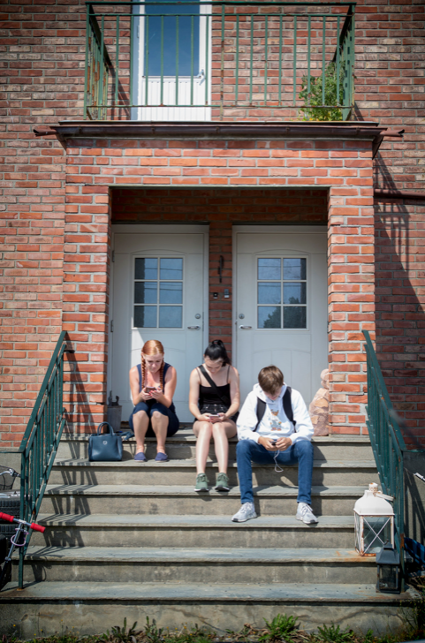
Asset based community development in Holmen
Examble of mobilizing resources:
Notes:
I want to share with you an example of a placed-based project that we’ve been doing the past year and a half.
We’re received funding from the county council to try an approach called asset based community development, also called ABCD.
So- what is ABCD? First of all: ABCD challenges the traditional deficit-based approach which is all about solving urban and rural development problems by focusing on the needs and deficiencies of individuals, neighbourhoods, towns, villages, etc.
ABCD demonstrates that local assets and individual strengths are key to ensure sustainable community development.

Slide 9
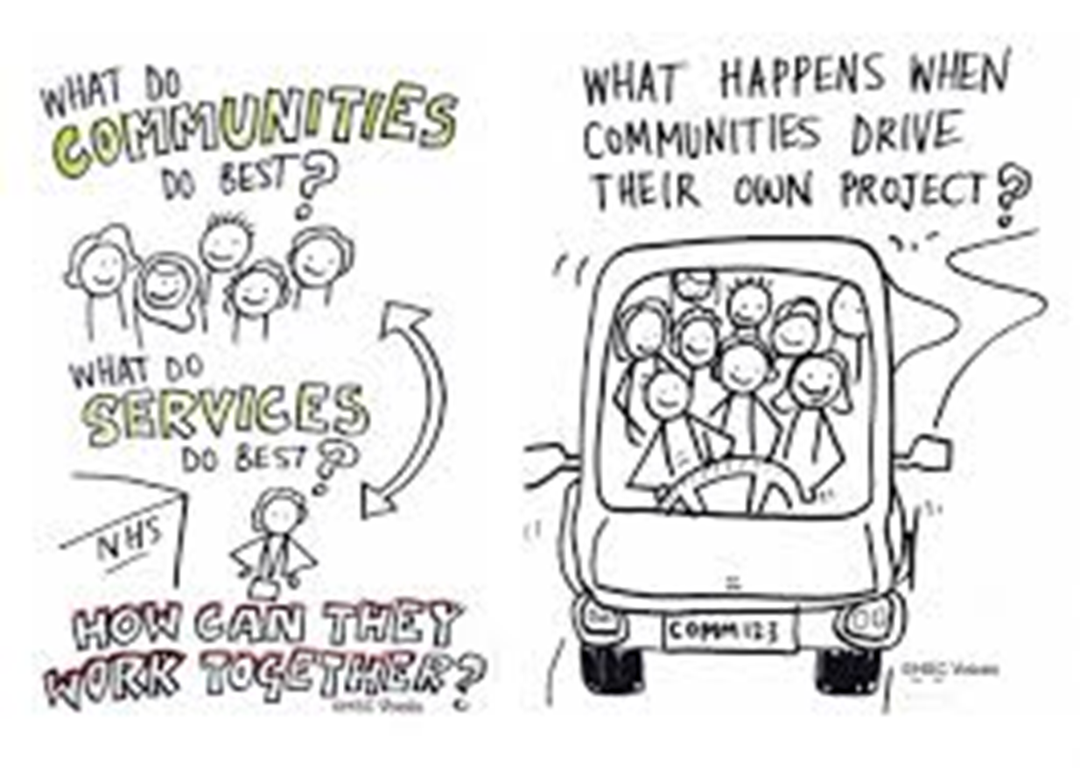
Three characteristics of ABCD
Asset based
Internally focused
Relationship driven
Notes:
The first principle that defines ABCD is that it is «asset based». We look to what’s strong instead of whats wrong.
Therefore our community development strategy starts with looking into what resources exists within the community
Looking at the capasity of its residents and workers, the associational and institutional base of the community.
The ABCD approach is by necessity «internally focused» meaning we look for resources and strengths within instead of searching outwards for help to fix problems.
Our community development strategy consentrates on citizens coming toghether setting the agenda for building and problem-solving capacities of local residents, local associations and local institutions.
ABCD work from three assumptions which is that
All citizens and social systems are resourceful
Sucess and improvements comes when resources in communities are made visible and connected
Empowered communities are build from the grassroot and when citizens passions and resources are brought attention

Slide 10
Notes:
We started a collaboration with mr. Cormac Russell from Nurture Developement in Irland to help us start our ABCD practice and we are currently becoming an ABCD Learning Site. We are now the first ABCD Learning site in Norway and that means that I will spend the next 3 years testing out ABCD in two neighbourhoods in Fredrikstad. From Nurture Development we will recieve guiding, mentoring, support in strategic work inside of the administration towards politicians,
Now i want to show you a video where Cormac Russell explains what ABCD is

Slide 11
Done to the people | Done for the people
Done with the people | Done by the people

Slide 12
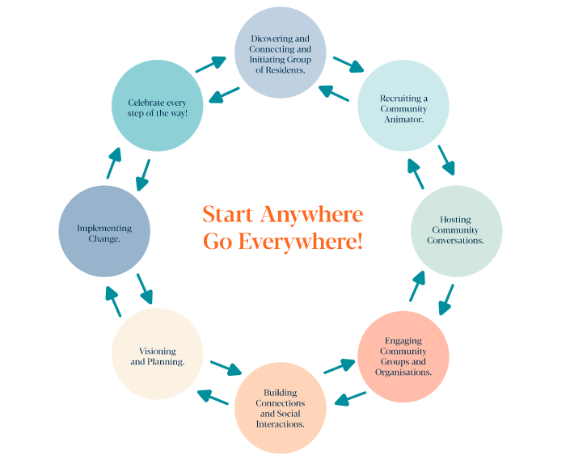
The ABCD Touchstones
Notes:
ABCD has eight touchstones:
Identify persons in the neighbourhood whom are willing to explore and identify fellow citizens strenghts and resources and then connect them
Host conversations from the starting point to find strenghts and resources inside the community
Map the local organizations and associations in the area and get to know what the stand for, work for and if they can be willing to collaborate with others. Then connect.
Building connections and soscial interactions
Create a shared vision and a plan for it
Get toghether to implement the change.
Celebrate every step of the way- also failures as they are valuable experiences

Slide 13
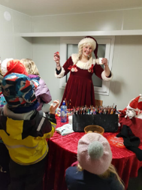
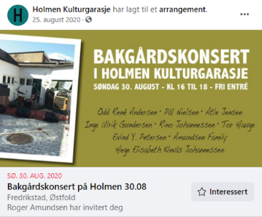
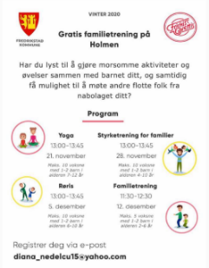
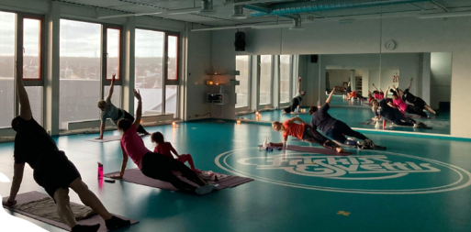
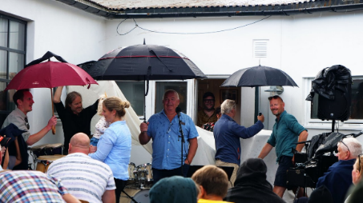
ABCD på Holmen
Notes:
Because of the pandemic-situation we are all currently experiencing little interaction with or between local citizens so far this year.
Hopefully things will turn out for the better in the coming months. So far citizens have been taking lead in the part of the city called Holmen.
This slide illustrates many of the happenings and acitivites local residents carried out themselves so far in our ABCD-project.
In the fall «Mesternes Mester
Kulturgarasjen og Kulturnatt in september
Christmas time «Nissefest»
Pizza og preik february 2020 – connect and networking
Kreative kurs i maling, foto, animasjon og fortellerkunst
Bakgårdskonsert i regi av Kulturgarasjen
Familietrening på Fresh for familier

Slide 14
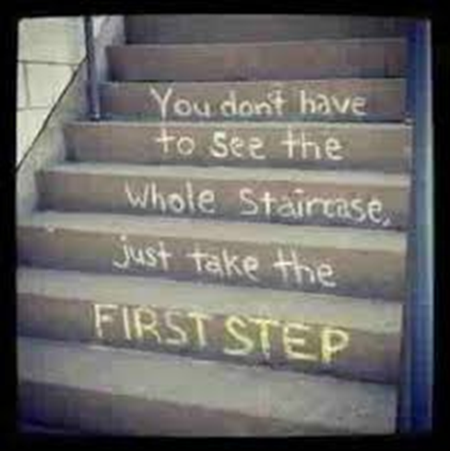
Thank you!
Notes:
That was it- any questions?

