Slide 1
Central Scandinavian Borderland- Round Table
Einar Ronæs
Head Of Section Market knowledge
10. februar 2017

Slide 2
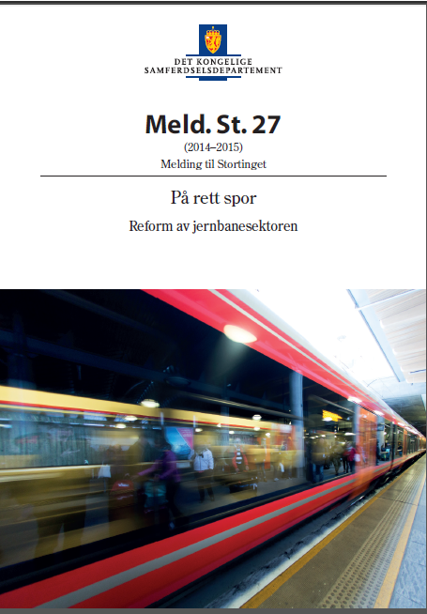
The purpose of the railway reform
Better customer orientation
More efficiency
Better coordination and management of the
sector
Less political detail controlling
The momentum of the reform is to deliver better service to freight industry and customers giving
"More railway for the investment."

Slide 3
«Railway Directorate will ensure that the railway sector is run as efficiently as possible, secure and environmentally friendly for the benefit of passengers, freight transport and society»

Slide 4
The Norwegian Railway Directorate
The Norwegian Railway Directorate is responsible for proposing long-term development of the rail transport offering in Norway. This includes development of infrastructure, passenger rolling stock, expertise and other input factors necessary to produce a train offering.
The Norwegian Railway Directorate presents investigations of future train services as a basis for political decisions.
The Norwegian Railway Directorate must coordinate the sector, conclude agreements with Bane NOR SF on the management and improvement of the rail network and service agreements with passenger service operators.

